Slide 2
General Objective
At the end of the teaching session, BNS 1st year will able to explain about Divorce and unmarried mother.

Slide 3
Specific Objectives
At the end of the teaching session, BNS 1st year students will able to:

Slide 4
Health promotion
Health promotion is the process of enabling people to increase control over and to improve their health.
(WHO 1986)
It is the process which empowers families and communities to improve their quality of life, achieve and maintain health and wellness. It emphasizes not only prevention of disease, but the promotion of positive good health.

Slide 5
Health promotional activities
Immunization
Safety and accident prevention
Screening
Counselling
Life style changes
Stress management

Slide 6
Immunization
Immunization refers to the process of acquiring immunity against a specific disease, with the aim of avoiding and reducing infections.

Slide 7
Purposes of Immunization
Vaccines greatly reduce the risk of infection.
Vaccines prevents infection and its spread to others.

Slide 8
Recommended immunization for adult
Flu Influenza Vaccine
To prevent Flu get vaccinated each year.
Administer 1 dose of age appropriate inactivated influenza vaccine or recombinant influenza vaccine annually.
Age group: 19 to 65years and above
Recommended dose:
Influenza live attenuated (LAIV) :0.2ml (0.1 ml into each nostril)
Influenza inactivated (HV) and recombinant (RIV): 0.5 ml/IM

Slide 9
Tdap or TD (Tetanus, diphtheria, pertussis)
Age group: 19 to 65 years +years.
Recommended dose : 1 dose of TD or Tdap if you do not get it as a child or adult.
Should get a Td booster dose every 10 years.
Women should get 1 dose of Tdap during every pregnancy (as soon as possible after confirmed pregnancy)
Recommended dose: 0.5ml/IM

Slide 10
Human Papilloma Virus (HPV)
Dose: 0.5 ml/IM
Routine vaccination:
Age 15 years or older at initial vaccination: 3 dose series (0, 1-2 month , 6 months interval)
(minimum intervals 4 weeks between doses 1st and 2nd dose , 2 weeks between 2nd and 3rd dose and 5 months between 1st and 3rd dose.

Slide 11
Continue of Human Papilloma Virus
Recommended through 26 years for everyone who do not get vaccinated in previous days..
Not recommended for everyone older than 26 years.
Clinician can consider if required for most likely to benefit

Slide 12
Shingles Zoster
Administer 2 doses of recombinant zoster vaccine (RZV): 2-6 months apart to adults aged 50 years or older.
Dose: 0.65ml, S/C
Special Precaution:
Zoster Vaccine Live (ZVL) is contraindicated for pregnant women and adults with severe immunodeficiency.

Slide 13
Pneumococcal disease
There are 2 vaccine that can prevent Pneumococcal disease:-
13-valent pneumococcal conjugate vaccine
(PCV13,Prevnar13) :0.5 ml, IM
23-valent pneumococcal polysaccharide vaccine (PPSV23,Pneumovax): 0.5 ml, IM or SC

Slide 14
Meningococcal disease
Meningococcal or Men B vaccine dose: 0.5 ml/IM (16-23 years to provide short term protection against strains of serogroup B meningococcal disease)
Hepatitis A vaccination
Dose: 1ml/IM (2 doses at 6 months apart)

Slide 15
Hepatitis B vaccination
Dose: 1ml/IM
Total doses: 3
1st at any time
2nd at least 1 months after 1st dose
3rd dose 6 months after 1st

Slide 16
Hemophilus Influenza Type B
Hemophilus Influenza Type B vaccine is often called Hib Vaccine
Recommendation:
Not routinely recommended for healthy adults
High risk of Hemophilus Influenza Type B.
Dose: single conjugated Hib Vaccine

Slide 17
Covid 19 vaccine
Vaccine: live attenuated vaccine
Pfizer: 2 doses (0.3 ml), at least 21 days apart.
Moderna: 2 dose (0.5 ml), 28 days apart
Johnson and Johnsons: 1 dose (0.5ml)
AstraZeneca: 2 dose (0.5ml), 4-12 weeks apart
Covid Shield: 2 dose (0.5ml), 12-16 weeks apart

Slide 18
Continue of Covid Vaccine
Age: more than 18 years
Route: IM into deltoid injection
MMR
Vaccine: MMRII
Recommendation: 19 to 55 years
Dose: 0.5ml/SC (1 or 2 doses)

Slide 19
Nursing Implication in Immunization
Nurses have responsibility to be up to date on a recommended routine vaccine
Documentation should be done properly
Get proper training before administrating vaccination
Always prepare and check for: Right dose, right route and right time of right vaccination.

Slide 20
Encourage client to administer full dose of vaccine
Provide health education about different vaccine regarding doses, routes etc.

Slide 21
Accident
Accident is an “unfortunate incident that happens unexpectedly and unintentionally , typically resulting in damage or injury.”
(Cambridge dictionary)

Slide 22
Types of accidents
Road traffic accident(80-90% of total cause)
Domestic accidents
Industrial accidents
Violence
Suicide and self inflected injuries.

Slide 23
Prevention of accidents
Data collection
Safety Education
Promotion of safety measures
Alcohol and other drug control
Elimination of causative factors
Enforcement of laws

Slide 24
Nursing responsibility
Caution young adults, especially males, who are the greater risk takers, about the safety precautions:
Drive defensively
Avoid alcohol beverages or drugs while driving or engaged in water, mountains or other sports
Observe the safety precautions for the specific activity

Slide 25
Educate about home safety
Follow speed limits and traffic rules
Avoid using cell phone while driving
At the bus stop, always follow the queue
Maintain safe distance for the speed with other vehicles

Slide 26
Do not sit, stand or travel on the footboard of the bus.
Do not put any part of your body outside a moving or a stationary bus
Avoid shouting or making noise while travelling in a vehicle as it can distract the driver
Always hold onto the handrail if standing in a moving bus, especially on sharp turns

Slide 27
Discuss stresses associated with work and how negative attitudes can contribute to accidents
Explore factors that increase anger and aggressive feeling
Use protective devices while performing risks associated activities
Initiate safety programs in various setting to avoid accidents and injuries.

Slide 28
Screening
It is defined as the presumptive identification of unrecognized disease in an apparently healthy, asymptomatic population by means of tests ,examinations or other procedures that can be applied rapidly and easily to the target population.
For e.g.-Pap smear for cervical cancer, X-ray for T.B, blood pressure for Hypertension etc.

Slide 29
Uses of Screening
Case Detection
Control of Disease
Research Purpose
Educational Opportunities

Slide 30
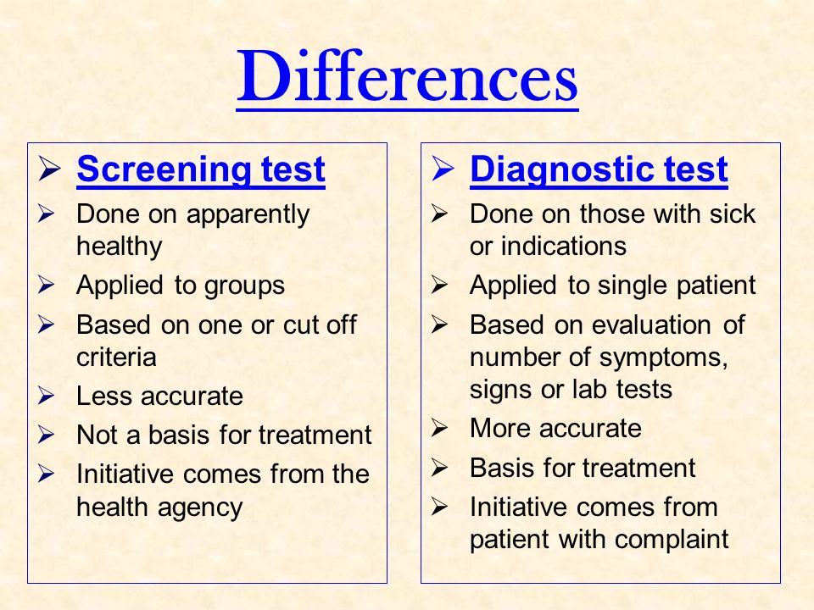
Difference between screening test and diagnostic test

Slide 31
Types of screening
Mass screening
High Risk/ selective/ Target screening
Multipurpose screening
Multiphasic screening

Slide 32
Different screening are performed in adults to monitor proper functioning of the body organs and to detect any abnormal condition are given below:
Blood pressure testing
Cholesterol screening and heart disease prevention
Diabetes screening
Kidney function test

Slide 33
Osteoporosis screening
Female: Breast, Uterus and Cervix
Male: scrotum, penis, prostate
Male and female: Skin
Thyroid screening

Slide 34
Colon cancer screening
Dental examination
Eye exam

Slide 35
Summary

Slide 36
References
Murray.B.R.“Health promotion strategies through the life span”, (1985), 8th edition, USA: Whitehouse book Ltd, page no;536-539,573.
Thapa ,u.(2010).common health problems of adulthood. Second edition. press, Kathmandu
Retrieved from www.merinews.com/article/counselling,retrieved on December 1,2020.

Slide 37
World health organization, Road traffic injuries, retrieved from www.who.int on December 1,2020.
https://www.cdc.gov/vaccines/schedules/hcp/imz/adult.html
http://www.adultvaccination.org/
https://www.who.int/immunization/policy/immunization_tables/en/
https://www.jwatch.org/na48462/2019/02/19/2019-us-adult-immunization-schedule

Slide 38
Home assignment:
Define accident. Enlist the preventive measures of Accidents
Define screening and list out the types of screening.
Plan for next class:
We will discuss about remaining nursing responsibilities in health promotion measures of adulthood.

